Slide 1
Working with Yield Data
A webinar focusing on cleaning and calibrating harvest data
Robbie Weathers
August 2020

Slide 2
Agenda Overview
AgStudio Yield Basics
Clean and Calibrate
Field Op Viewer
ARS
Yield Site Editor

Slide 3
Housekeeping
During the webinar, write any questions in the Q&A box. My co-presenter will provide answers, or, if we have time, we can address them at the end of the session. If not, we can follow up after.
The following day after the webinar, you will receive an email which includes a link to our AgStudio Help site for the recording and slide deck. These are useful to train additional staff, or if you need a “refresher”.
During this webinar, we will ask you to participate in some Q&A to make sure that we are getting our information across; so you might want to jot down some notes.

Slide 4
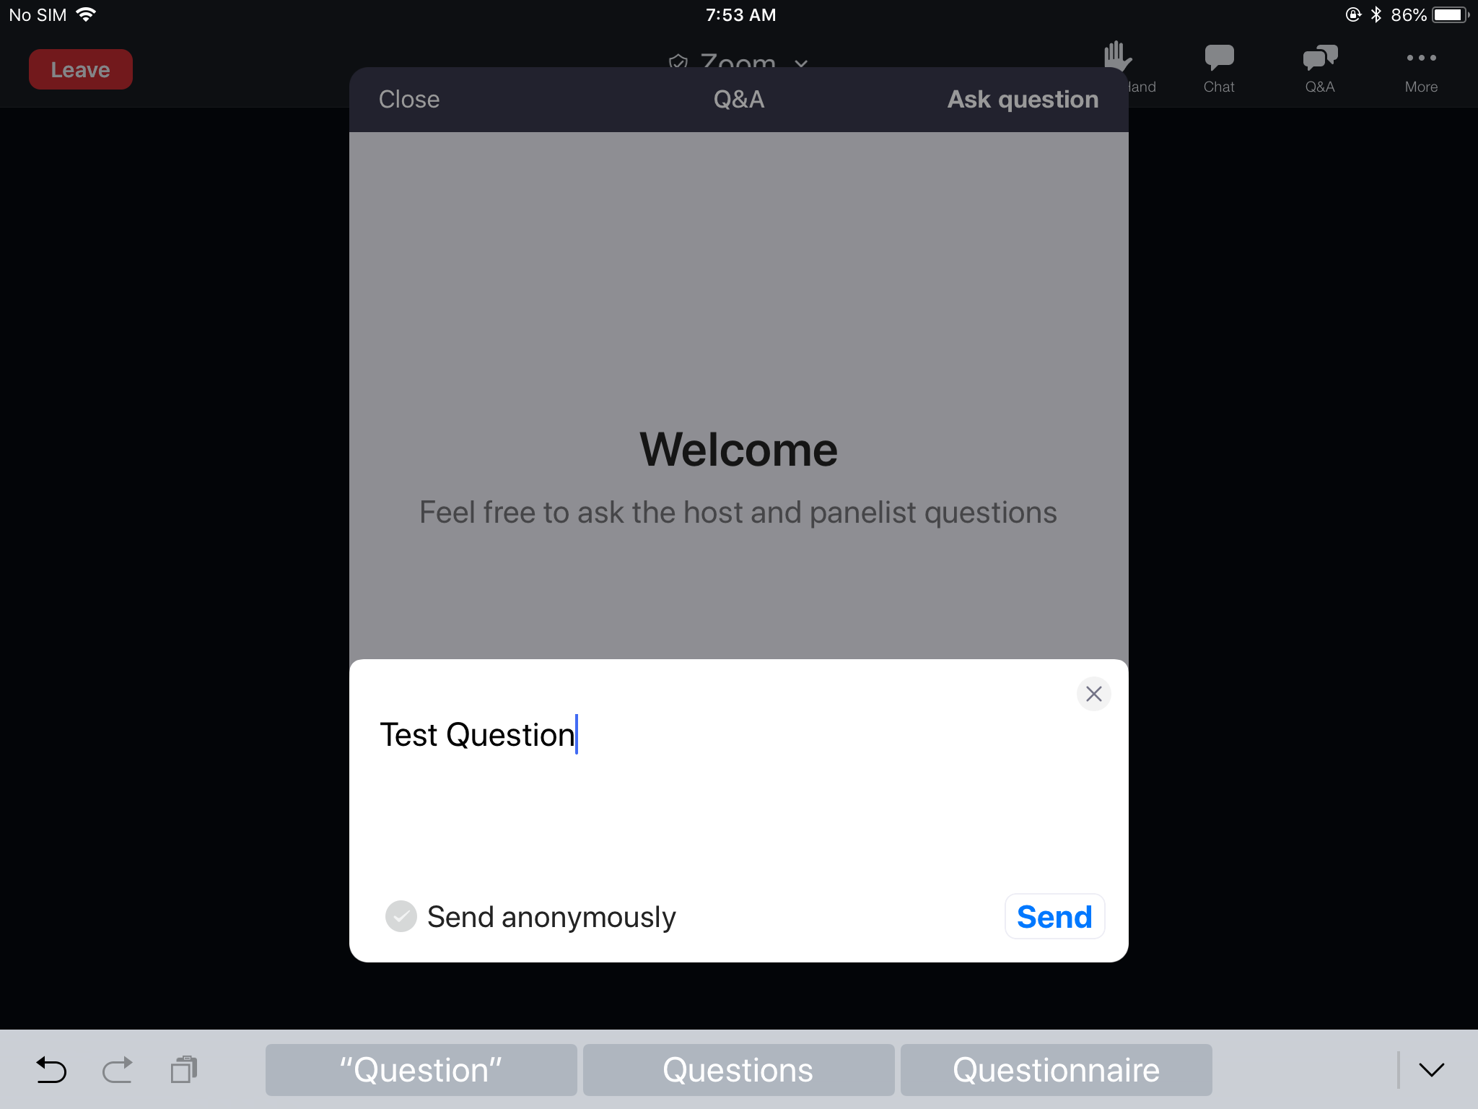
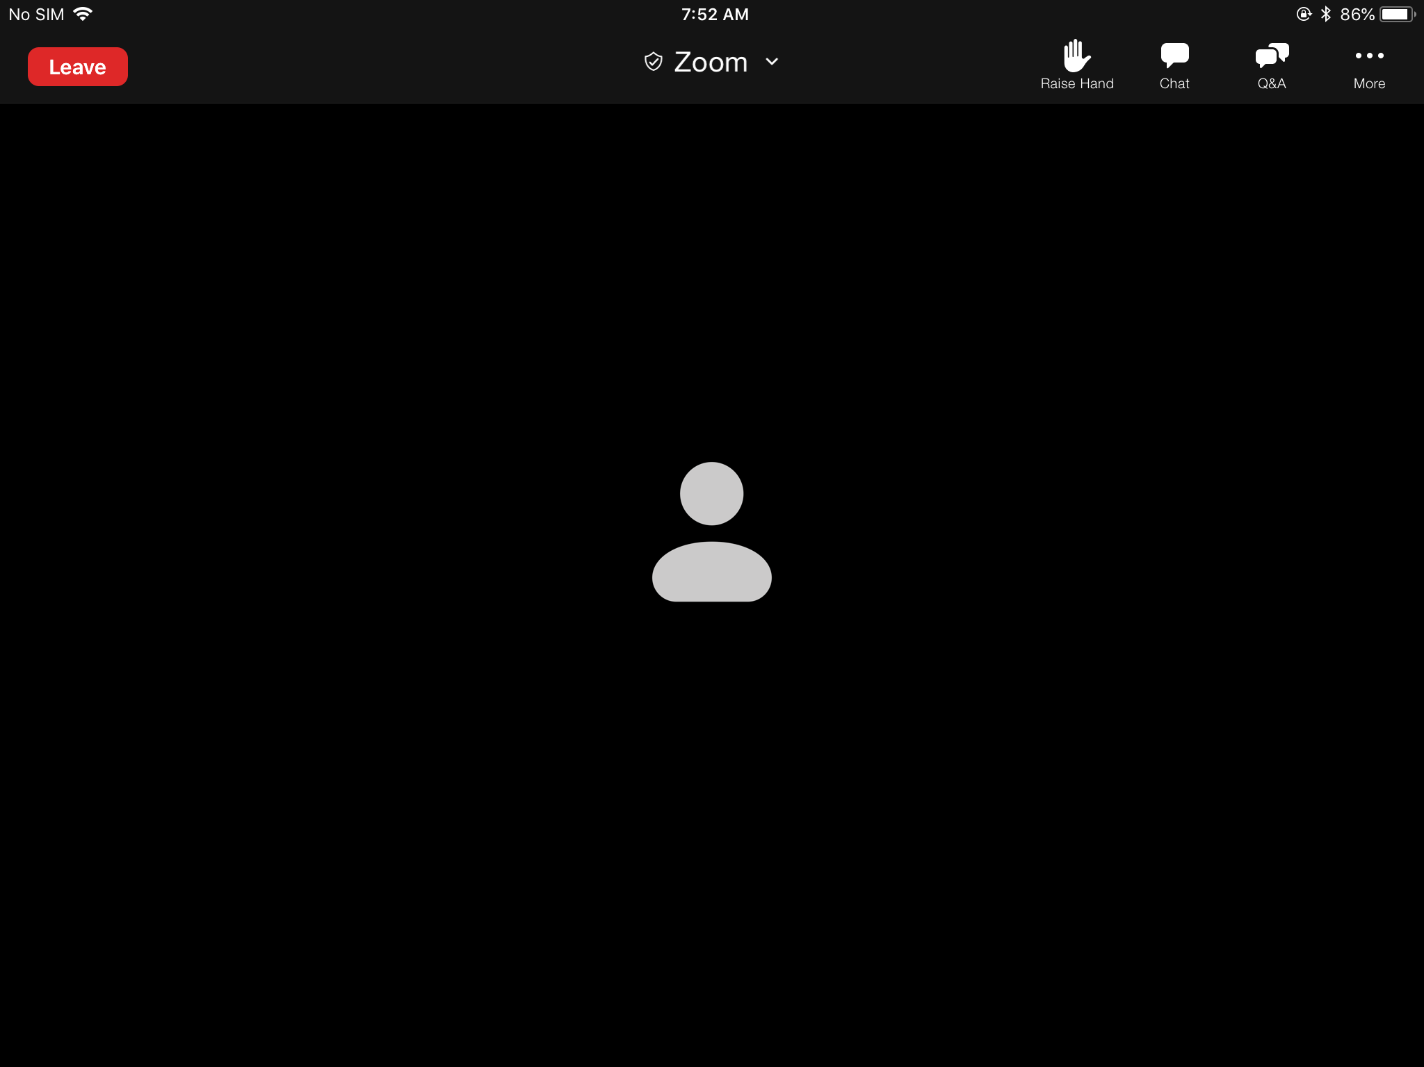
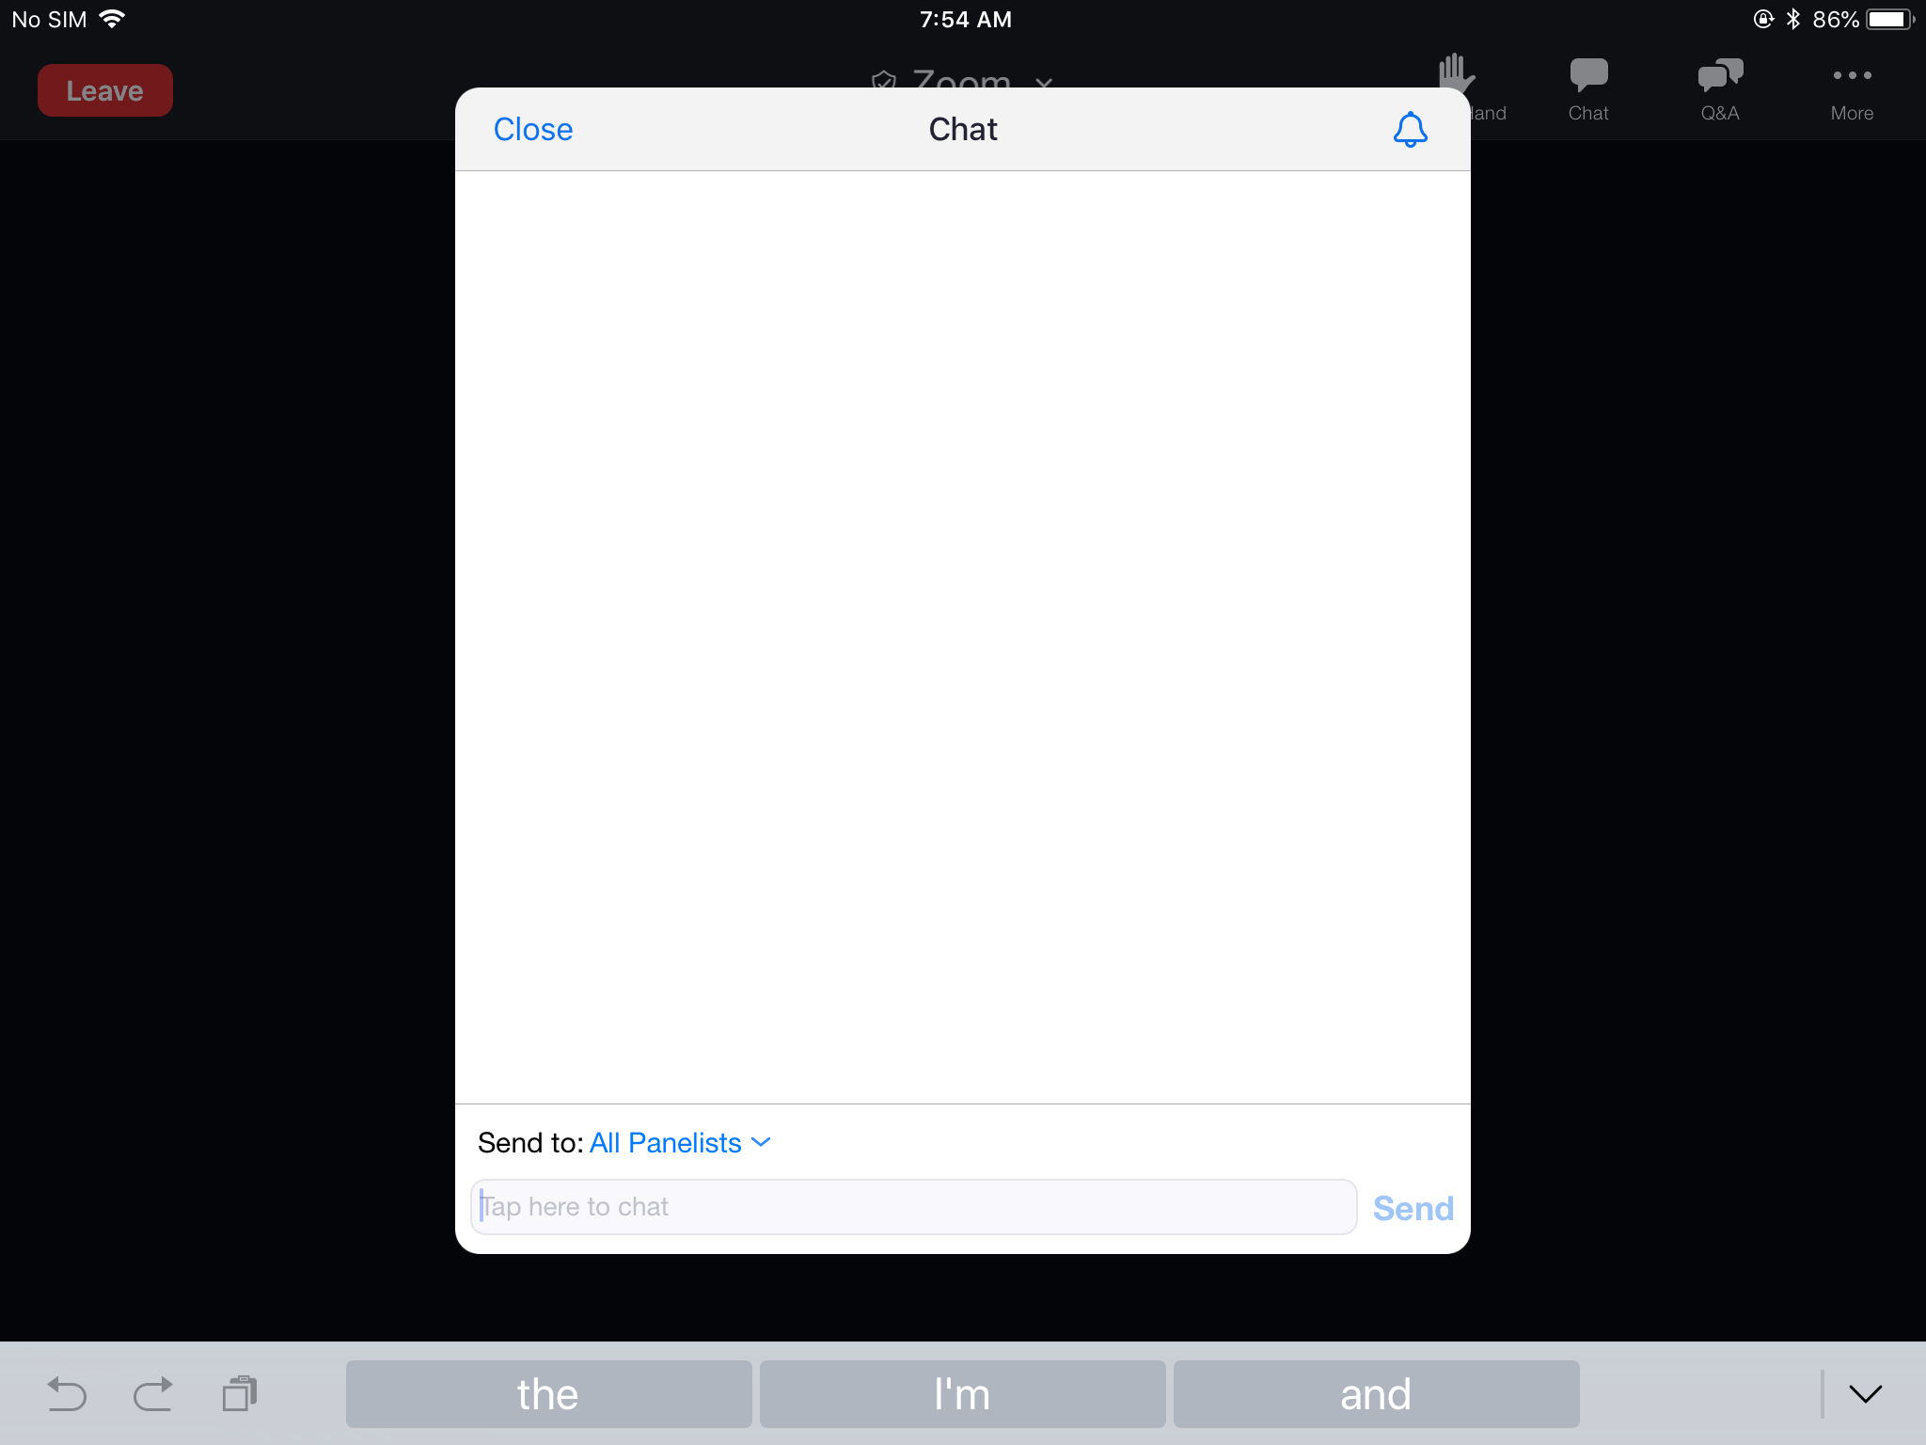
Zoom Webinar

Slide 5
Prerequisite Knowledge
All these can be found on the webinars link on the AgStudio Help Center site.
Product Setup and Themes – click here to view for Crop, Commodity, Product setup
Importing and Linking Data – click here to view for Importing Data and Field Op Resource Linker product linking
Notes:
Suggested but not required

Slide 6
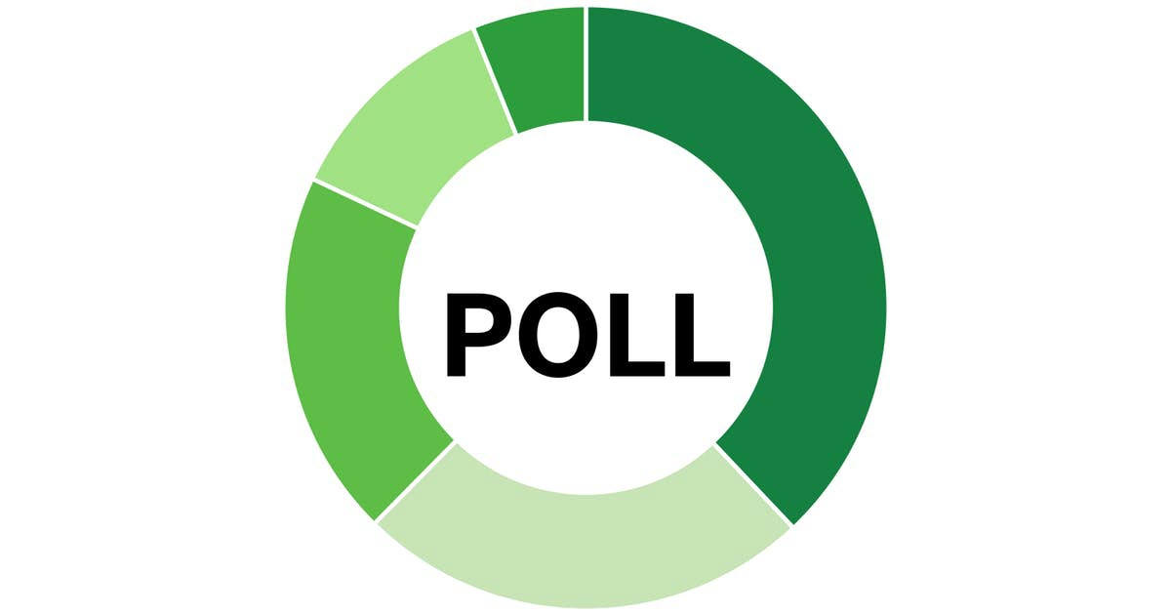
Notes:
Are you currently cleaning or calibrating yield data?
Yes
No

Slide 7
Yield Basics
Why do we need to clean yield data
How is yield determined
Commodity Setup
Definitions
Changing Data
Change Commodity
Reset Data

Slide 8
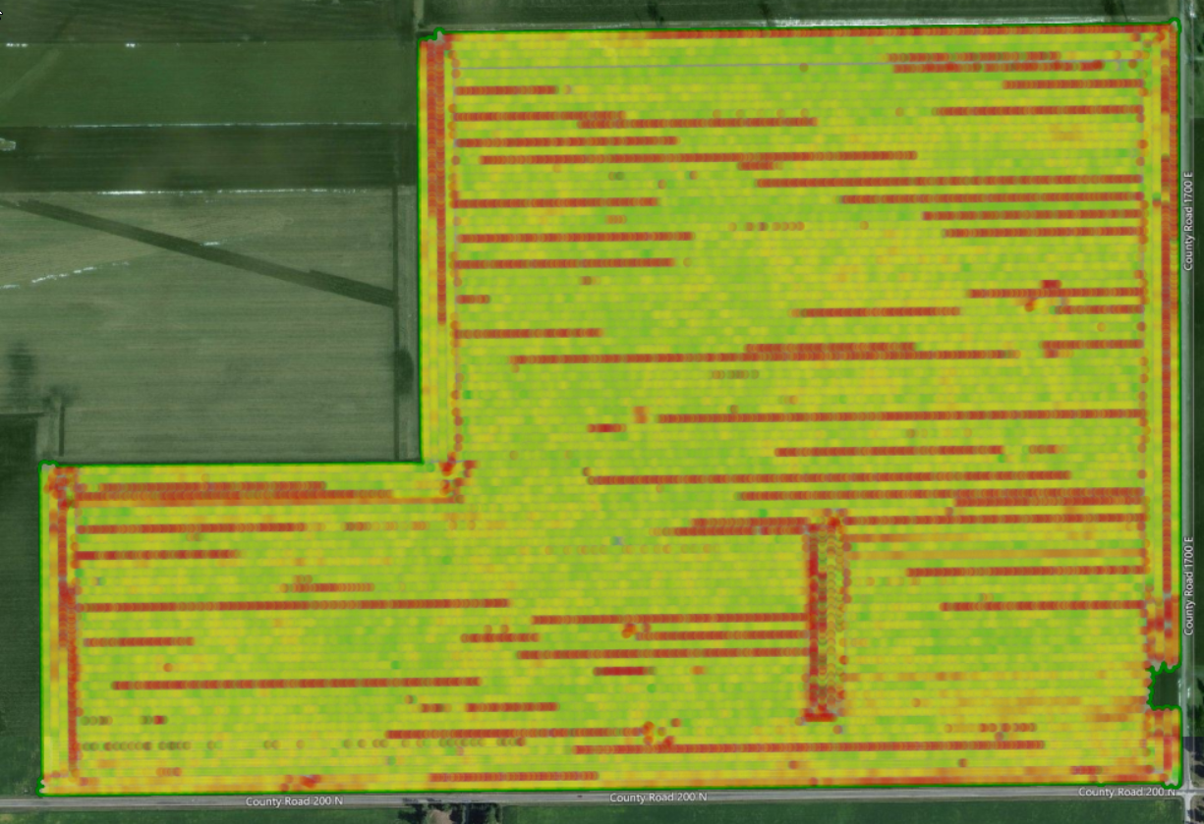
Why do we need to clean yield data
AgStudio
Fix mapping issues from the field
Correct bad sensor readings
Correct weight issues
Why?
Needed for accurate analysis and reporting totals
8

Slide 9
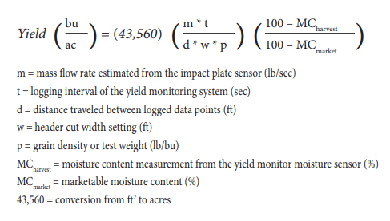
How is Yield Determined in Studio
AgStudio
9

Slide 10
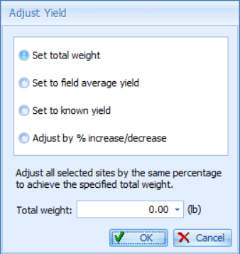
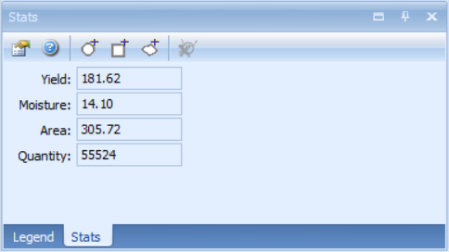
Definitions
AgStudio
Weight = Wet Weight
Yield = Dry
Moisture = Moisture%
Except in Cotton Moisture = Turnout %
Under the stats tab the quantity displayed is the dry bushels on the field.
10

Slide 11
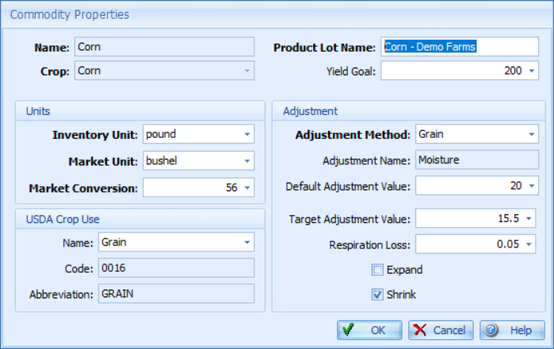
Commodity Setup- Why does this matter?
AgStudio
Used to convert from units in the field to Market units
Bu for Grain
Pounds or Bales for Cotton
Use to adjust from wet yield to a dry yield
Default is what is used if no moisture value is provided from the data
Target is the value the commodity is sold at
Grain - The standard shrink calculation used for grain commodities: Dry Yield = Wet Yield * ((100 - Actual Moisture Content) (100-Std Moisture) - Respiration Loss).
Cotton - Lint Weight = Seed Weight * Turnout Percentage.
11

Slide 12
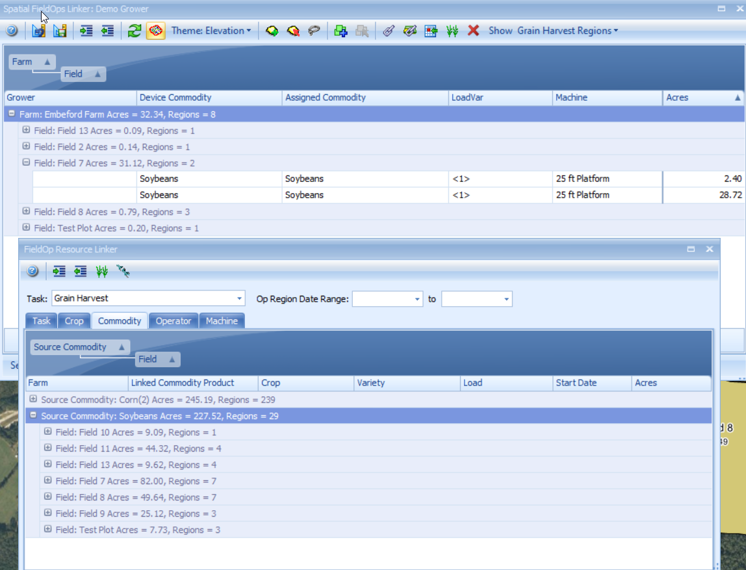
Change Data
AgStudio
How to change commodity on data
Spatial Field Ops
Resource Linker
Resetting data
Unlink then relink
Will reset commodity or any changes made in ARS
12

Slide 13
Clean and Calibrate
Field Op Viewer
ARS
Yield Site Editor

Slide 14
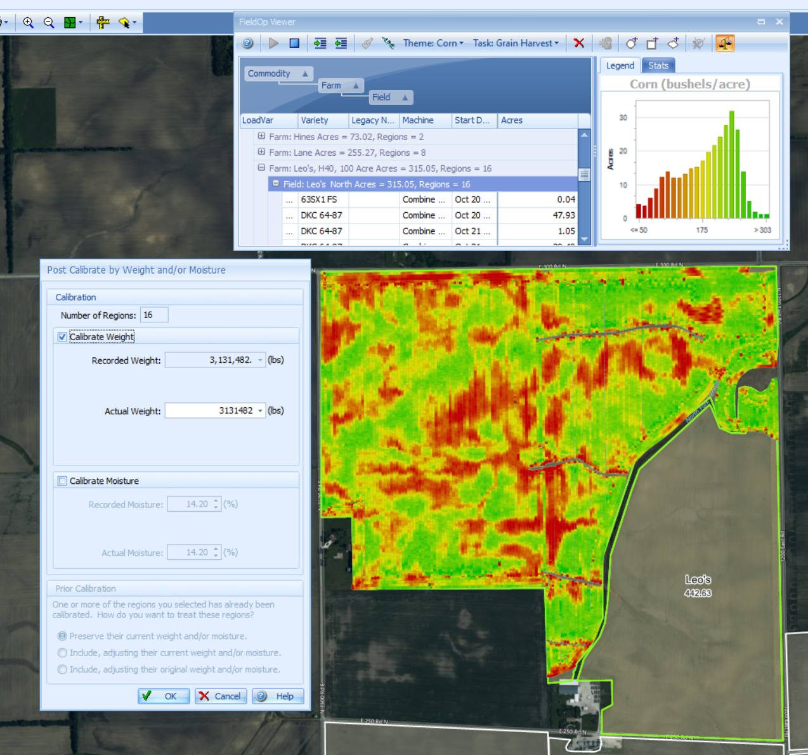
Field Op Viewer
Clean and Calibrate
Used to calibrate data at a high level- (Field, Farm, Grower, Crop)
Can adjust the weight or moisture to known values.
Applies a scale factor to all selected regions
14

Slide 15
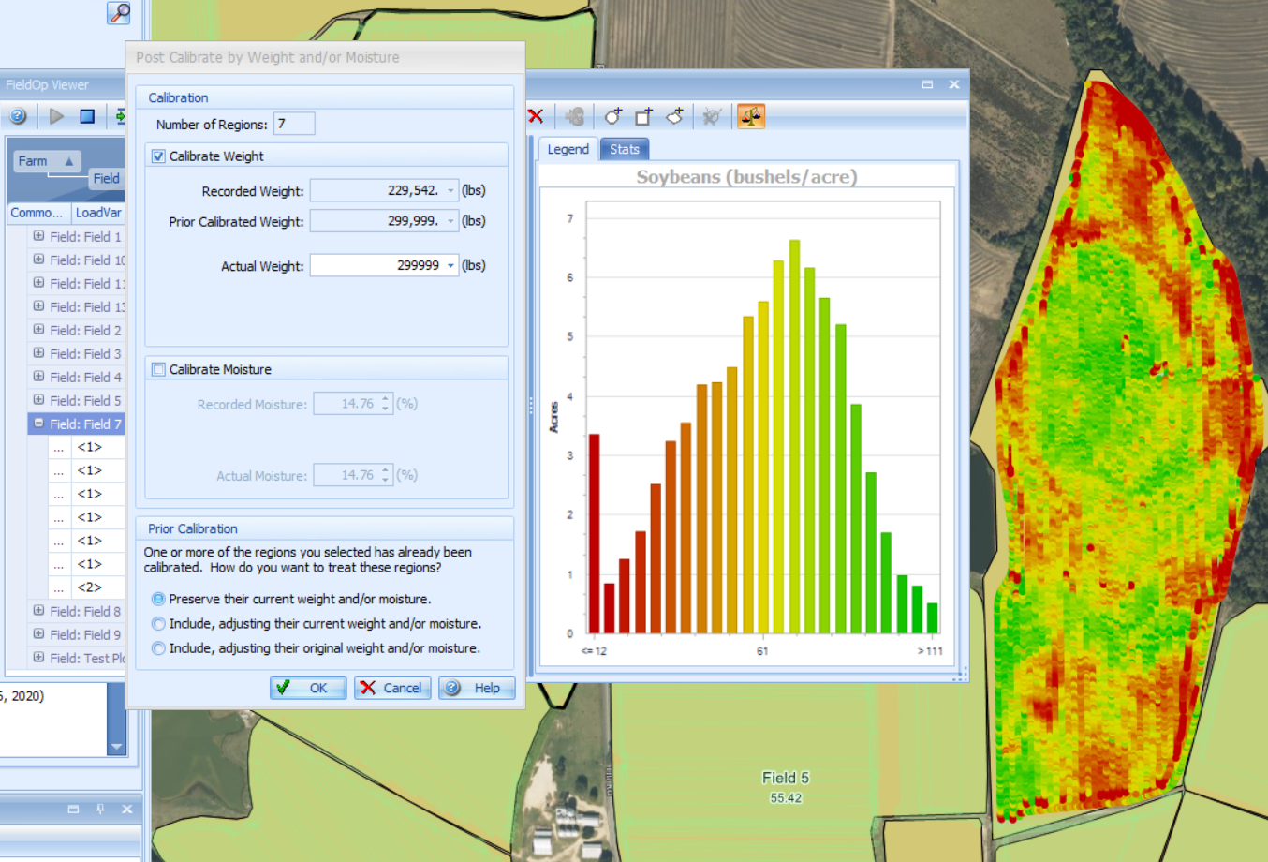
Field Op Viewer
Clean and Calibrate
If a region has already been calibrated, you will get 3 options when you select it again.
Preserve- Keeps the calibrated regions the same and adjust the rest
Include, Current- Adjust all the regions
Include, Original- This starts the process over
15

Slide 16
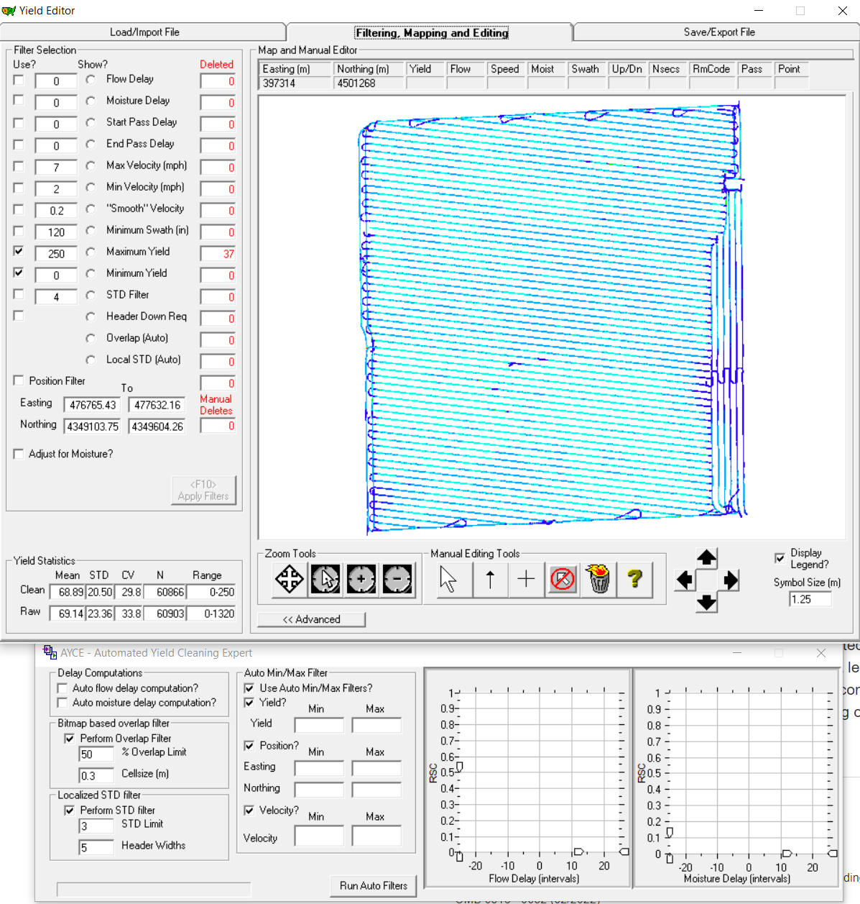
ARS
Clean and Calibrate Data
ARS is a third party software used to clean and adjust yield data
Can be downloaded from the link below.
https://www.youtube.com/watch?v=yFvyX8qsxNo
https://www.ars.usda.gov/research/software/download/?softwareid=370

Slide 17
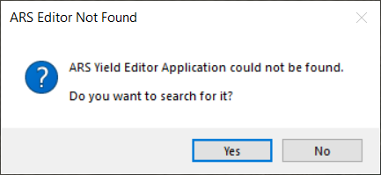
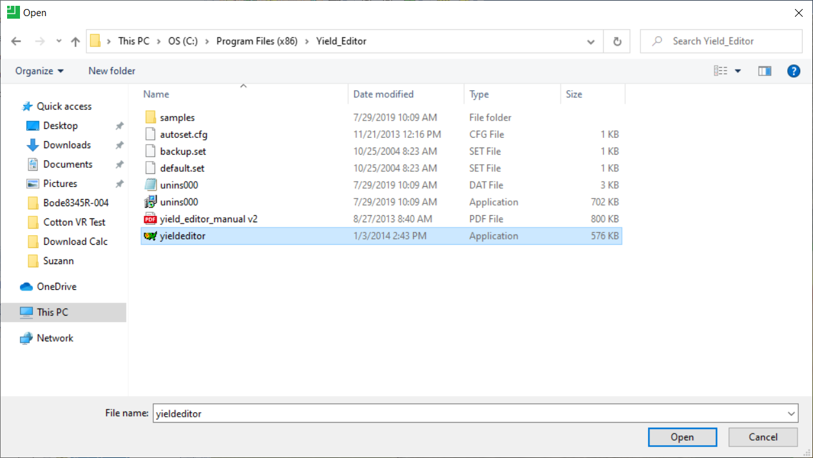
ARS
Clean and Calibrate Data
How to find it?
Search in C Drive-ProgramFiles (x86)-Yield_Editor to find the application
https://www.ars.usda.gov/research/software/download/?softwareid=370

Slide 18
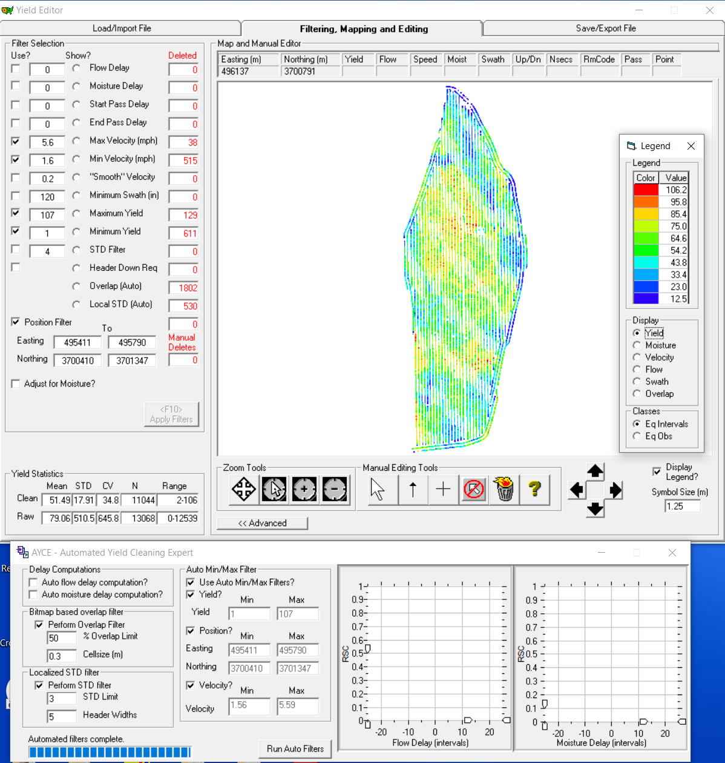
ARS
Clean and Calibrate Data
Select the Harvest FieldOp you want to clean in your domain tree
FieldOps- Edit Yield Data (ARS)
Try running the Run Auto Filters first to see if that corrects your data
https://www.ars.usda.gov/research/software/download/?softwareid=370

Slide 19
ARS
Clean and Calibrate Data
Can use the filter selection in ARS to fine tune the data.
Check the options or change the numbers and then select apply filters.
https://www.ars.usda.gov/research/software/download/?softwareid=370

Slide 20
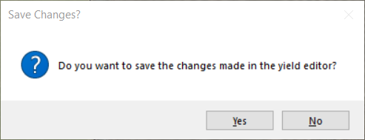
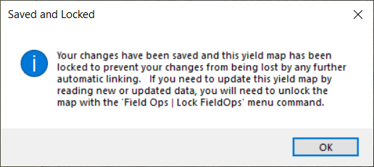
ARS
Clean and Calibrate Data
Once you have the data corrected, you close ARS and this message will show in Studio
If you select yes, you will see this message
To unlock the FieldOp, right click on the op and select lock FieldOps and then unlock
If you need to reset back to original data, unlink and relink the Fieldop
https://www.ars.usda.gov/research/software/download/?softwareid=370

Slide 21
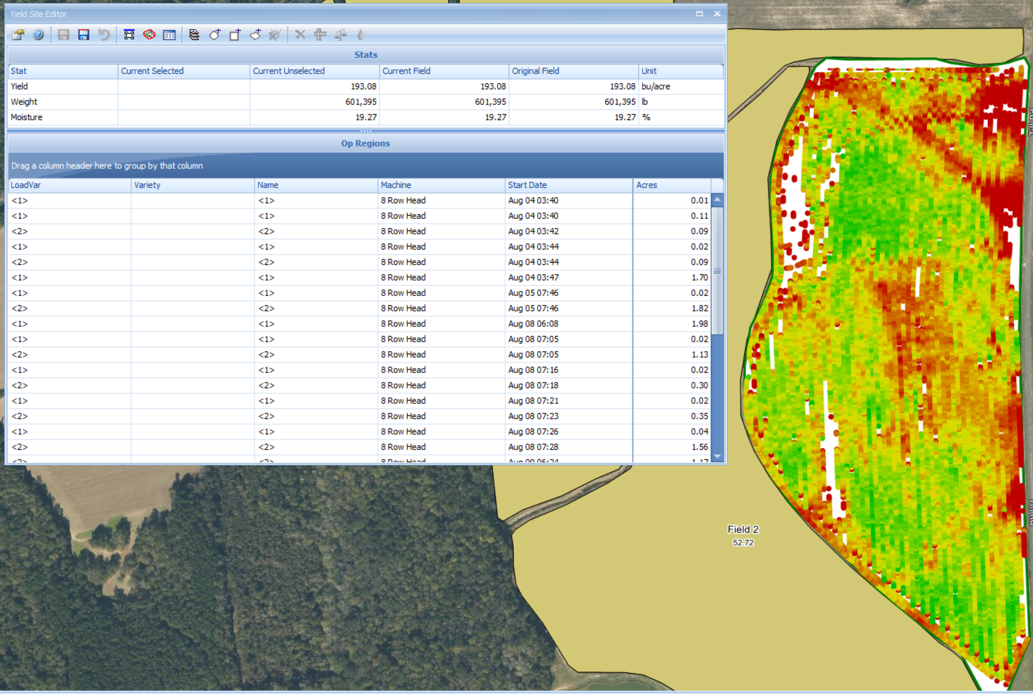
Yield Site Editor
Cleaning and Calibrating Data
Used to selectively adjust yield data
Can adjust weight, moisture, swath by machine, or selected area

Slide 22
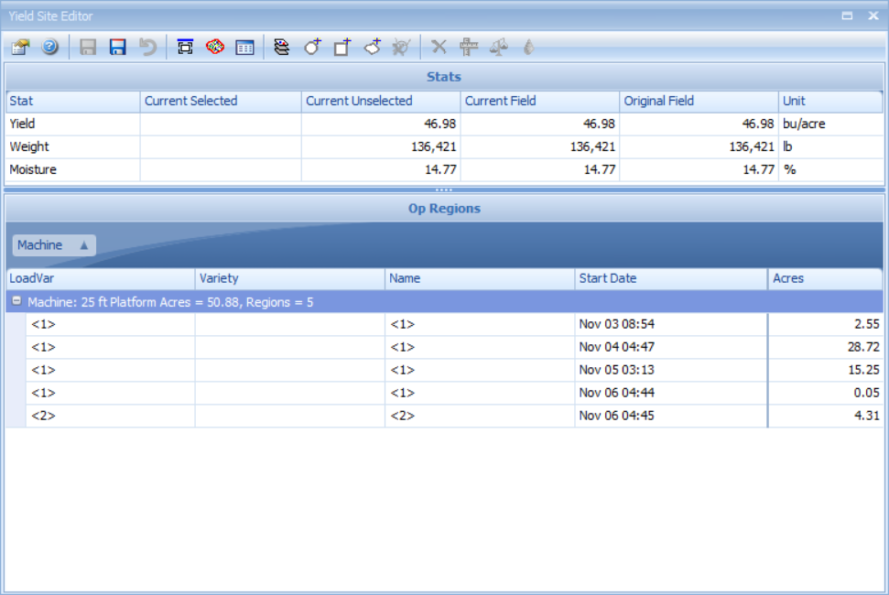
Yield Site Editor
Cleaning and Calibrating Data
To use the tool the Harvest fieldop needs to be selected in the domain tree
Go to FieldOps- Yield Site Editor
Have ability to sort data to help selection by dragging a column into this area

Slide 23
Yield Site Editor
Cleaning and Calibrating Data
Data Selection Options
By Grid
By Pass
Select by
Circle
Rectangle
Polygon
Clear Selection

Slide 24
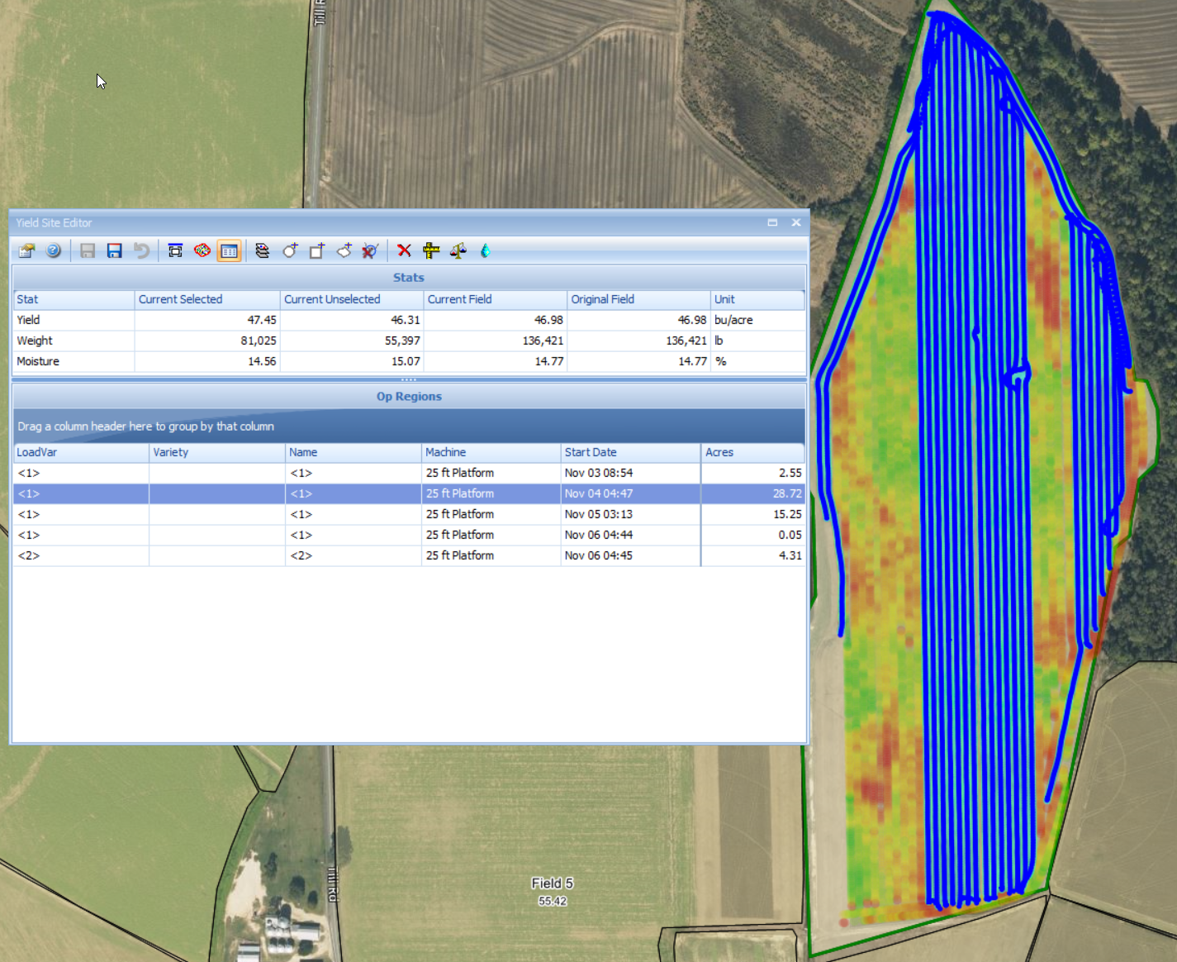
Yield Site Editor
Cleaning and Calibrating Data
Data Tools
Delete
Hard Delete
Width
Yield
Moisture

Slide 25
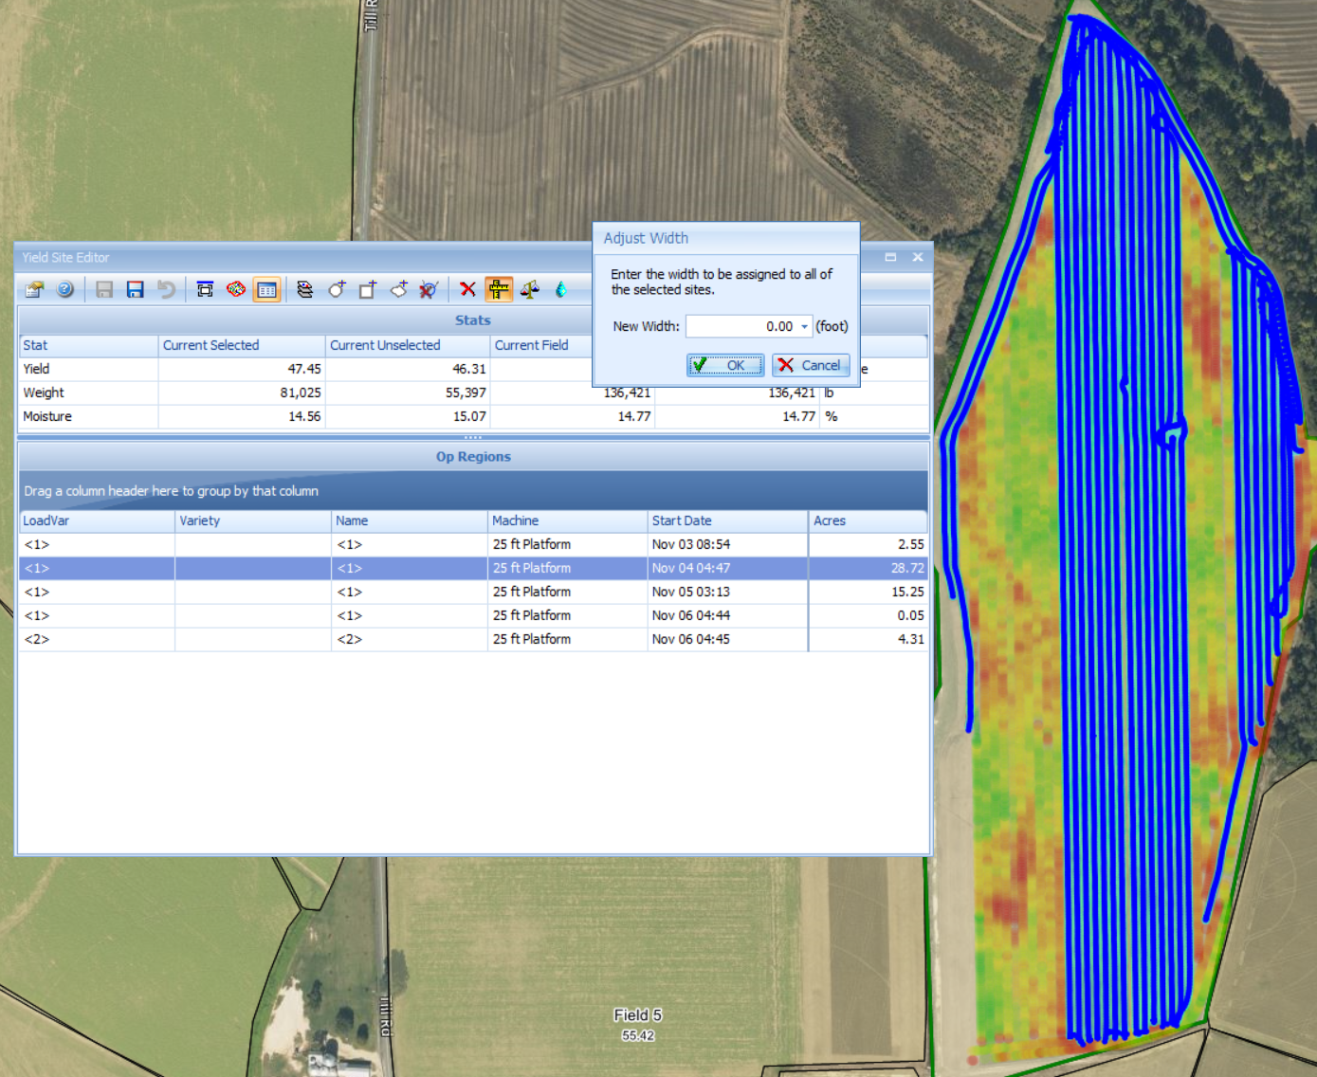
Yield Site Editor
Cleaning and Calibrating Data
Data Tools
Width
Allows for the adjustment of swath width of the selected area

Slide 26
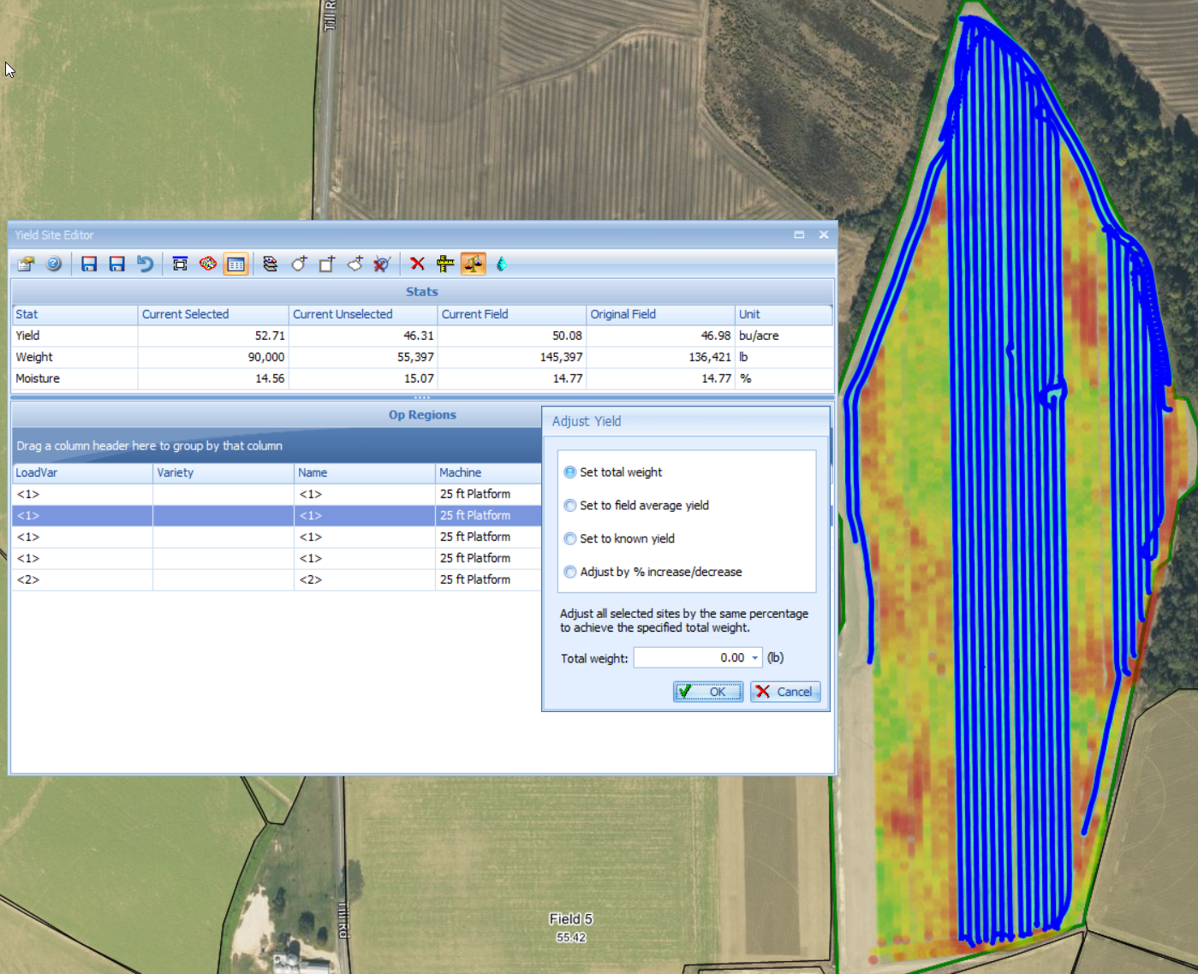
Yield Site Editor
Cleaning and Calibrating Data
Data Tools
Yield
Set total weight
Set to field average
Set to known yield
% increase or decrease
After adjustment you can see the new totals

Slide 27
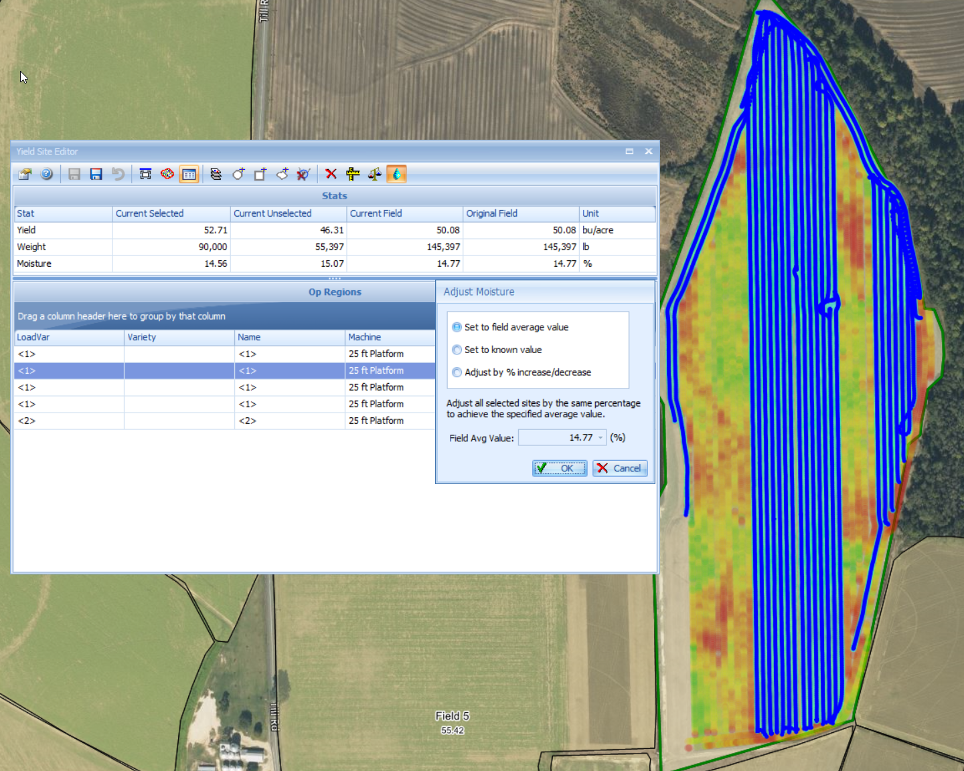
Yield Site Editor
Cleaning and Calibrating Data
Data Tools
Moisture
Set to field average
Set to known value
Adjust by percentage
After adjustment you can see the new totals

Slide 28
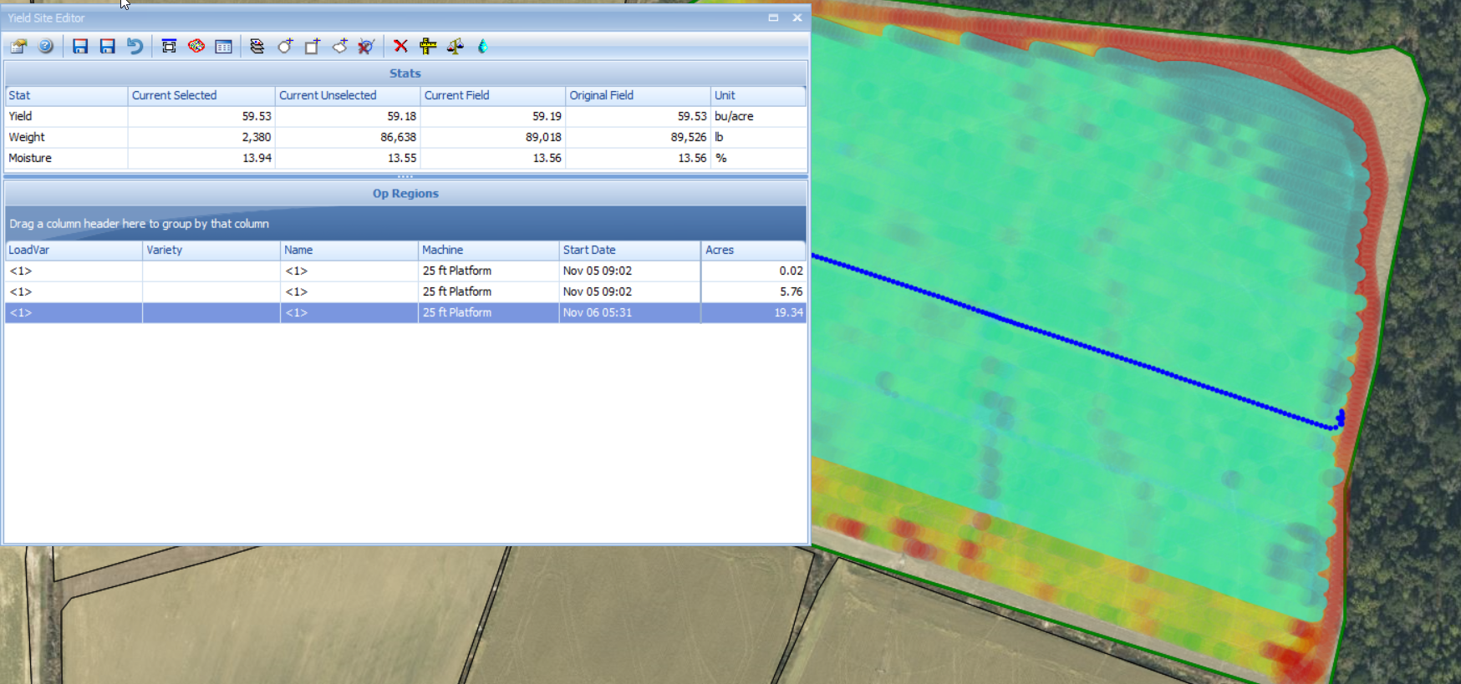
Yield Site Editor
Cleaning and Calibrating Data
Data Tools
Save options
Save with edits
Save without edits
Undo

Slide 29
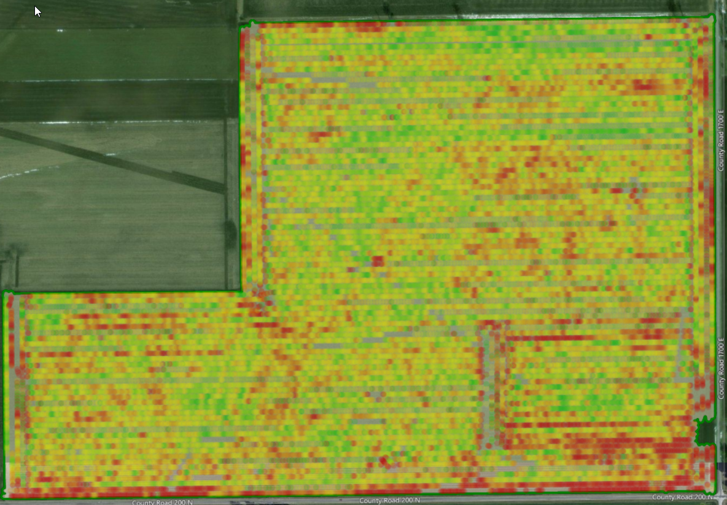
Cleaning and Calibrating Data

Slide 30
AgStudio Support
Monday – Friday: 7am – 5pm, Central Time
Email - agstudiosupport@granular.ag
Phone – (833) 933-1733

